Slide 1
CHAPTER: 1 Economics, Economy and its Central Problems
Class – 11

Slide 2
PRODUCTION POSSIBILITY FRONTIER
It refers to a graphical representation of possible combination of two goods that can be produced with given resources and technology
Assumptions -
Resources are fixed
They can be transferred
Only two goods can be produced.
Resources are fully and efficiently utilized
Resources are not equally efficient in production of all products
Technology remains constant

Slide 3
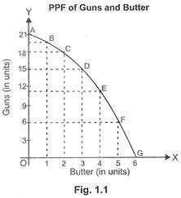
FIGURE

Slide 4
SCHEDULE
Production Possibilities [OR Combination] | Guns | Butter | MRT
A | 21 | 0 | -
B | 20 | 1 | 1:1
C | 18 | 2 | 2:1
D | 15 | 3 | 3:1
E | 11 | 4 | 4:1
F | 6 | 5 | 5:1
G | 0 | 6 | 6:1

Slide 5
Explanation
When points A, B, C, D, E, F, & G are joined we get a curve AG, known as ‘Production Possibility Frontier.’
AG curve shows the maximum limit of production of guns and butter.
Every point on PPC [like A, B, C, D, E, F& G] in figure indicates full employment and efficient use of resources.

Slide 6
MARGINAL OPPORTUNITY COST
MOC refers to the number of units of a commodity sacrificed to gain one additional unit of another commodity. In case of PPC, MOC is always increasing.
Reason:- Increasing MOC operates because productivity and efficiency of factors of production decrease as they are shifted from one use to another

Slide 7
MARGINAL RATE OF TRANSFORMATION
MRT is the ratio of number of units of a commodity sacrificed to gain an additional unit of another commodity.
MRT =  Units Sacrificed
❒ Units Gained
MRT increased because it is assumed that no resources is equally efficient in production of all goods.

Slide 8
CHARACTERISTICS OF PPF
PPF SLOPES DOWNWARDS: More of one goods can be produced by only by taking resources away from the production of another good.
PPF is CONCAVE SHAPE: Because of increasing MRT. MRT increases because it is assumed that no resource is equally efficient in production of all goods.

Slide 9
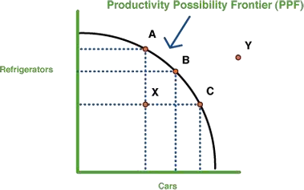

Slide 10
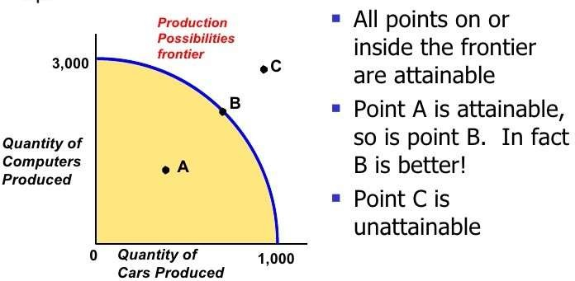
ATTAINABLE AND UNATTAINABLE COMBINATIONS

Slide 11
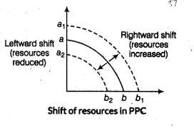
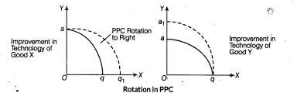
CHANGE IN PPC
SHIFT IN PPC: When there is change in productive capacity with respect of both the goods.
ROTATION OF PPC: When there is change in productive capacity with respect to only one good.

Slide 12
Questions :
Why is PPC downward sloping from left to right?
Can PPC curve be a straight line?
Write the basic properties of PPC?

